Slide 1


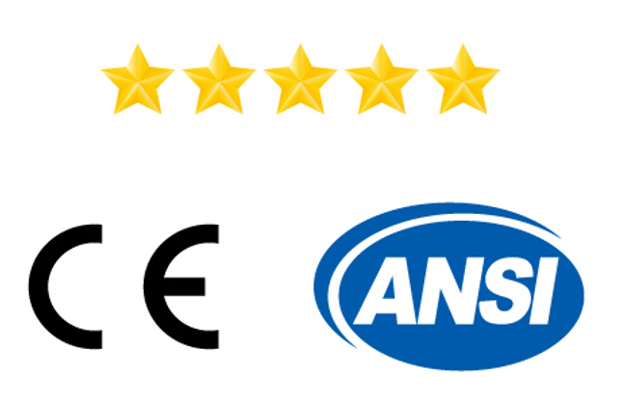
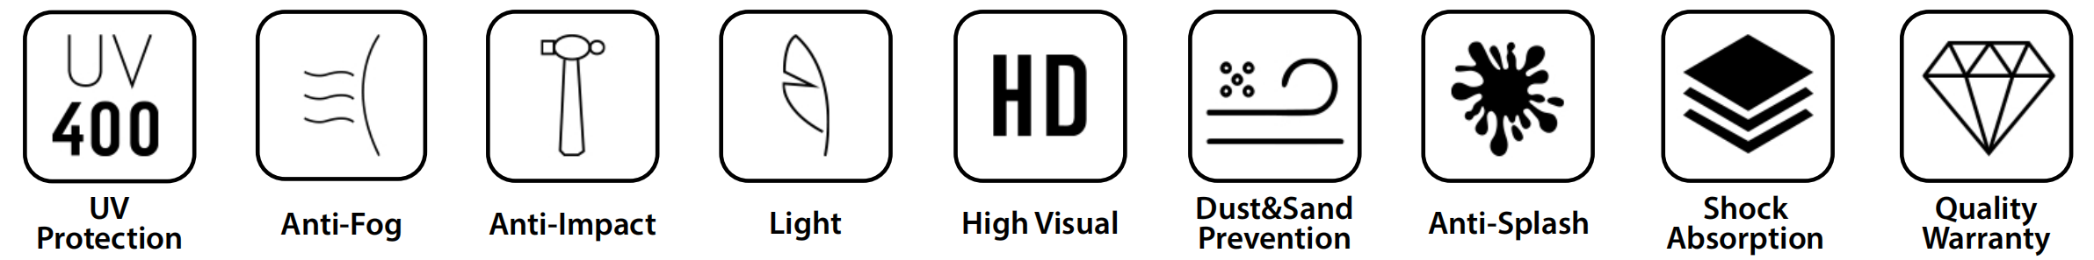
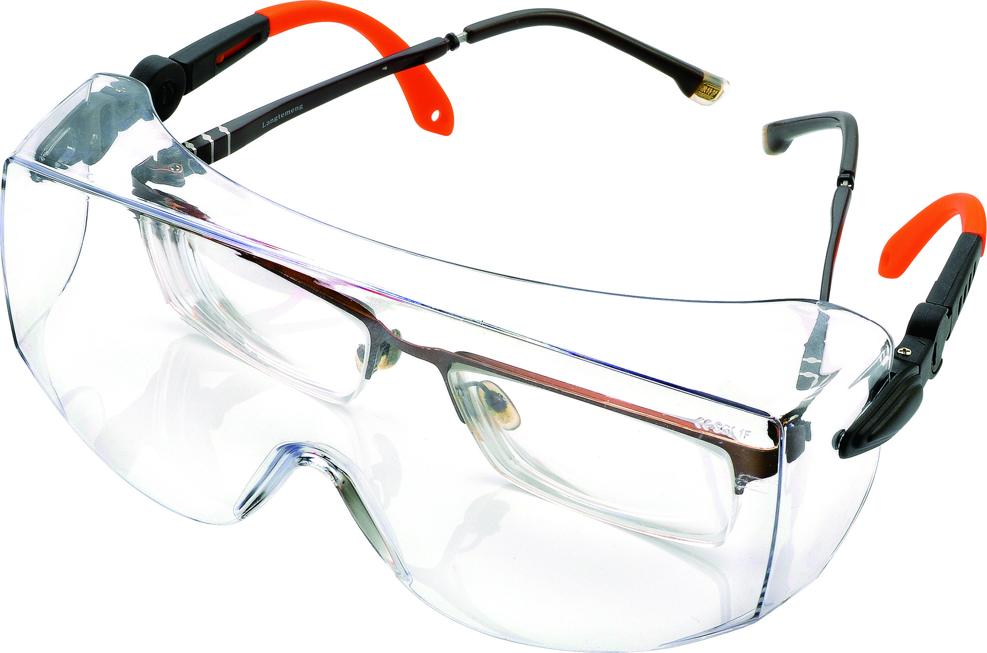
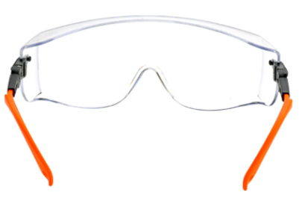
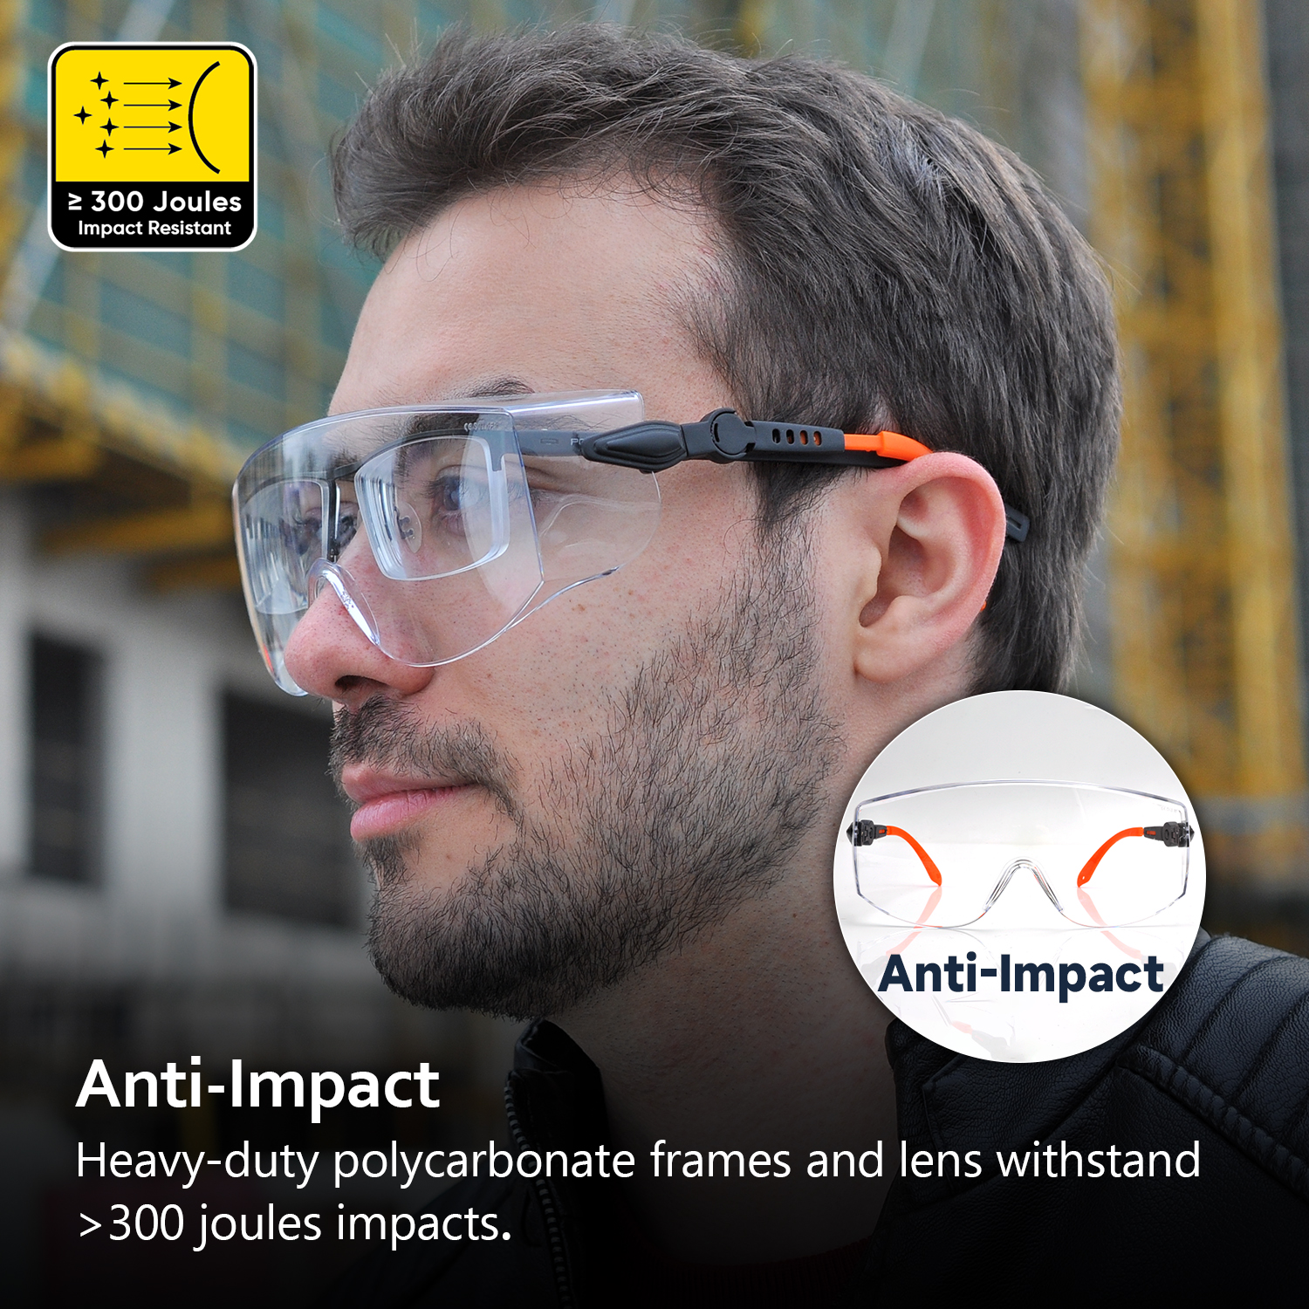
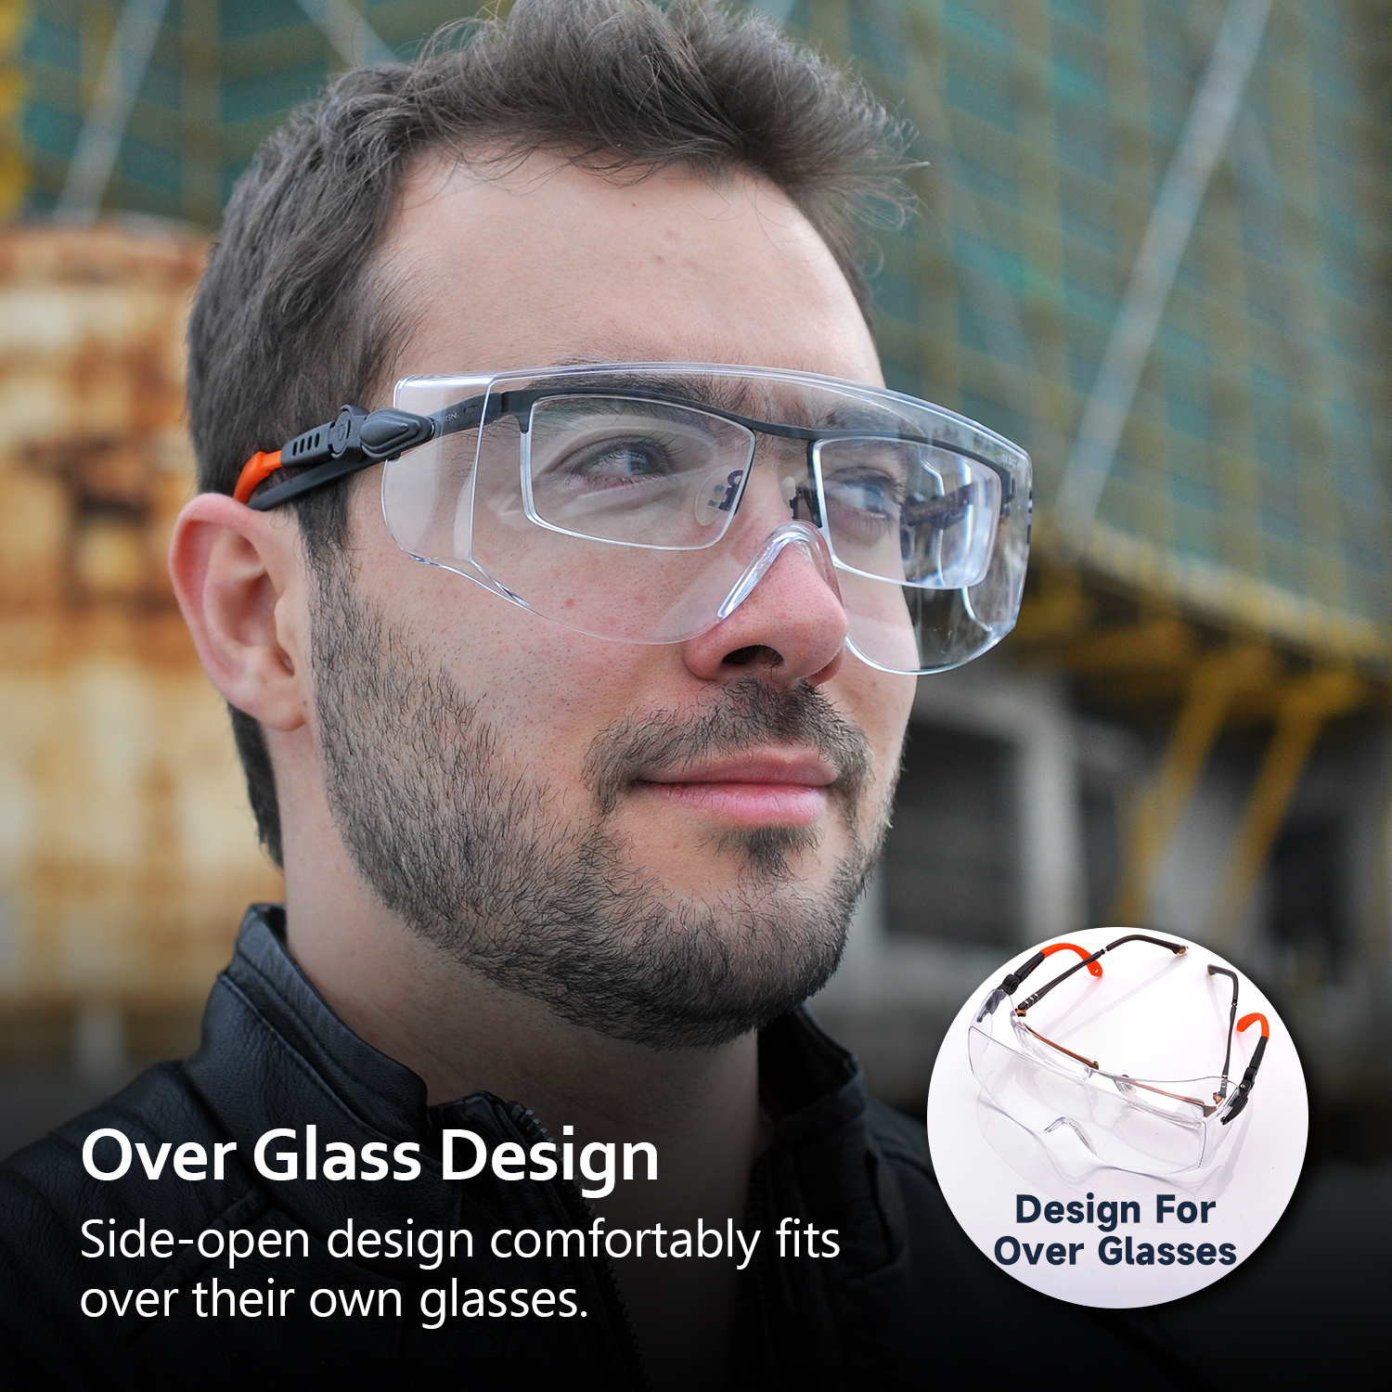
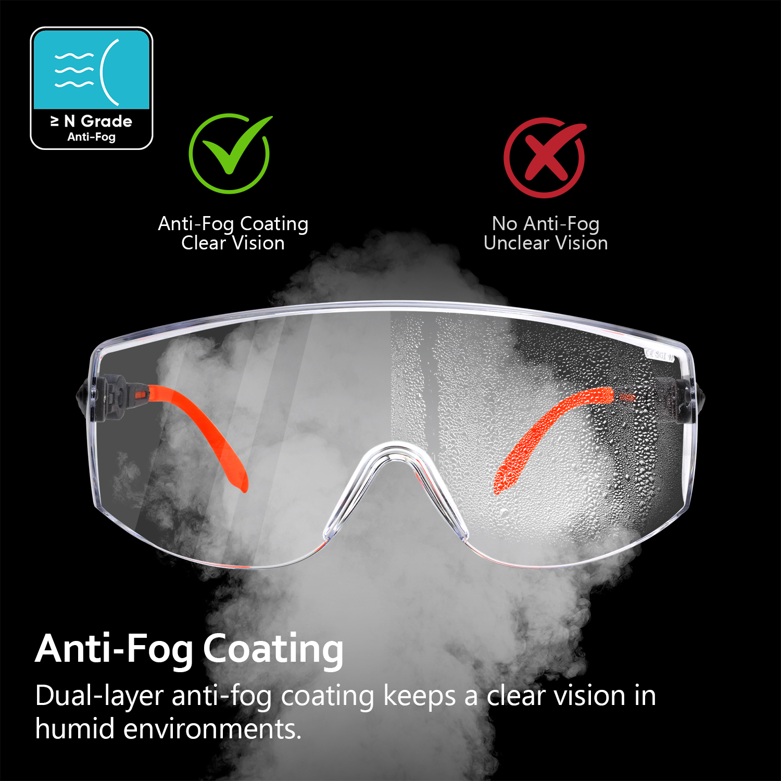
SAFETY EYEWEAR
Adjustable Fitting & Over-Glassed Safety Glasses . SG009 (BoundlessGuard)
Frame:Heavy Duty Polycarbonate (Face Pressure≤ 8g/mm²)
Lens: Super Clear PC Lens（Anti-Fog Coating）
Legs: Lightweight PC Legs (Adjustable Fitting)
Leg Tips: Slip Resistant & Comfortable TPR Tips
CE EN ISO 166:2001 Notified Body: 2834 (CCQS )
ANSI/ISEA Z87.1-2020 Certified by ICS Laboritories
√ Anti-Impact
√ Over Glasses
√ Anti-Fog

Slide 2
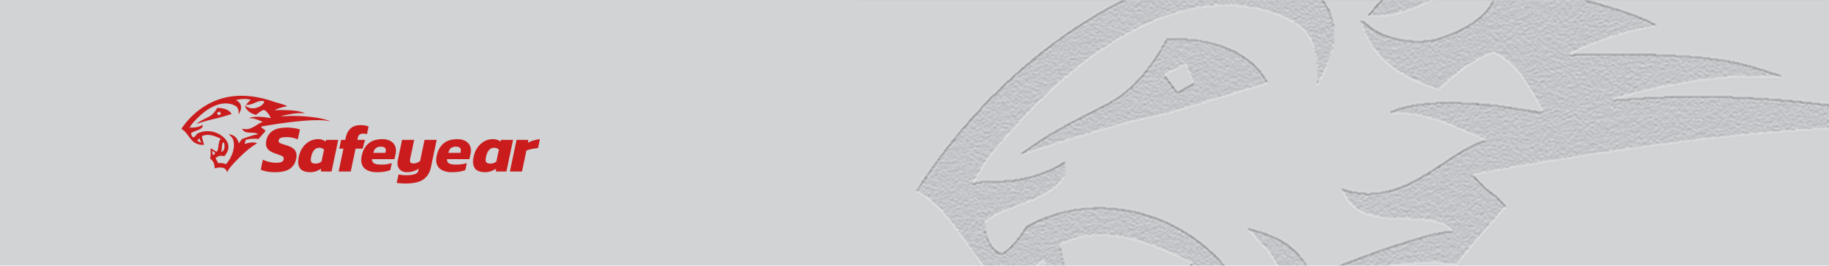
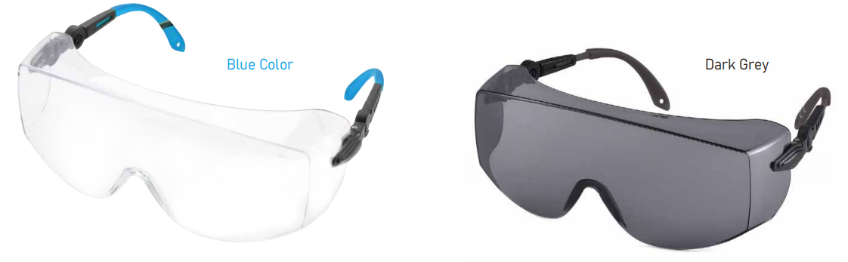
√ EN ISO 16321-1:2022 Protection again low/high spead particles
Impact Point | Impact Speed | Defects | Result
Left Eye Frontal | Low Energy(F) | Not Occurred | Pass
Right Eye Frontal | Low Energy(F) | Not Occurred | Pass
Left Eye Side | Low Energy(F) | Not Occurred | Pass
Right Eye Side | Low Energy(F) | Not Occurred | Pass
√ Oculars Without Filtering Ation | Result
Test Requirement: Lumious Transmittance should be more than 74.4% | Pass
Standard: CE EN 166:2001
√ Diffusion of Light | Result
Test Requirement: Performance parameter (cd/(m².lx))should be less than 0.75 | Pass
Standard: CE EN 166:2001
Color Available: Clear, Blue, Dark etc
User Instruction:
1.) Recommend to Use: Eye protection workplaces, such as Construction, Grinding, Metal Cutting, Painting, Workshop, Laboratory, Shooting, Cycling etc
2.) Standard & Quality: The protective eyewear meets EN ISO 166:2001 standard for Personal Eye protection. These products are classed as Personal Protective Equipment (PPE) by the European PPE new regulation (EU) 2016/425. It also meets ANSI/ISEA Z87.1 USA standard.
3.) Using This Eyewear: This eyewear offers protection against describe what risks it protects against. These spectacles are fitted with filtering lenses that protect against sun-glare and provide impact protection against high speed particles at low energy and the goggle provides protection from liquid droplets.
4.) Warning: Check the eyewear regularly for noticeable scratching, pitting or any other damage to the lens, scratching, pitting, or other damage to the lens can seriously reduce the level of impact protection provided by the product.
5.) General: Whereas the material used in the constructing of this product is safe parts that may come into contact with wearer’s skin could cause allergic reaction by susceptible people. The user should check for any such reaction and cease use of product if any reaction is observed.
6.) Lifespan: Maximum product use life is 2 years. If any parts are broken during use, please don’t use it any more and change a new glasses asap, to avoid any danger to your health.
7.) Storage: Eyewear should be stores at room temperature and away from solvents, or solvent vapors or any corrosive materials, as these may seriously reduce the impact protection provided by the eyewear.
8.) Cleaning: This eyewear can be cleaned and disinfected with soap and warm water. It is recommended that wiping of lens be kept to a minimum and only done so with a soft nonabrasive cloth.

