Slide 1





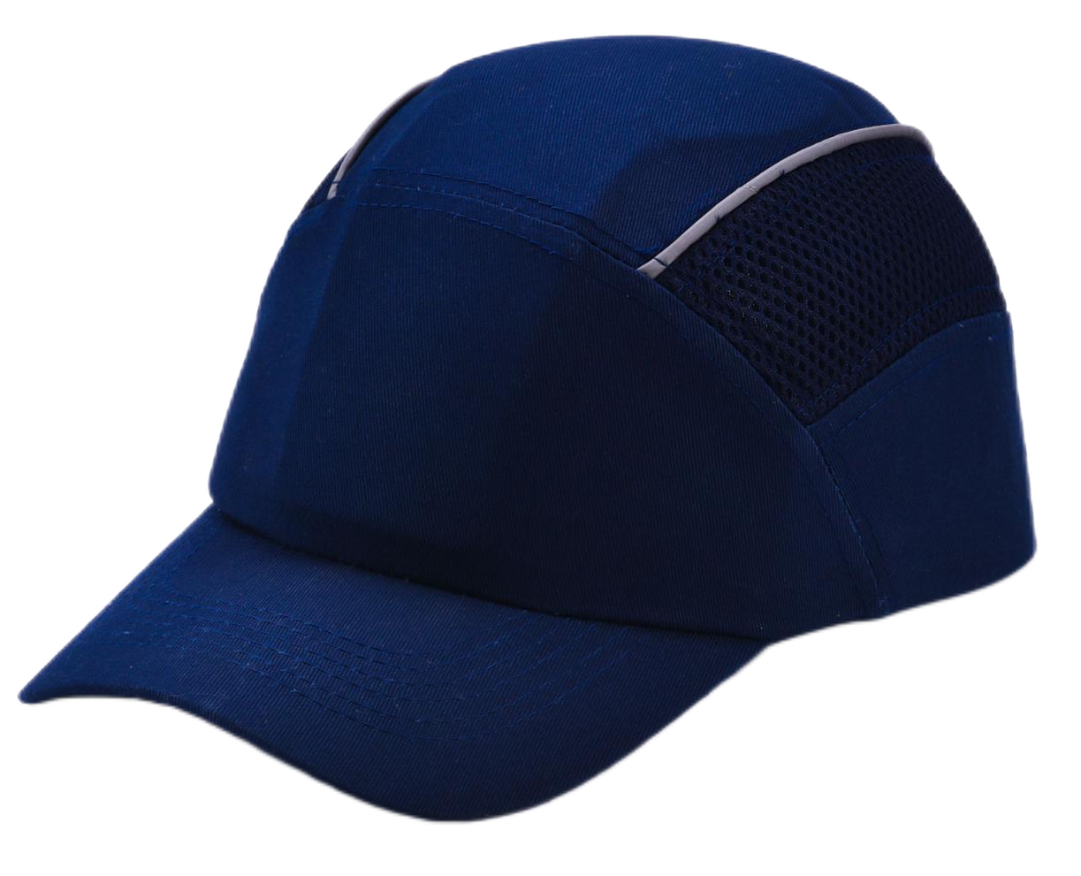
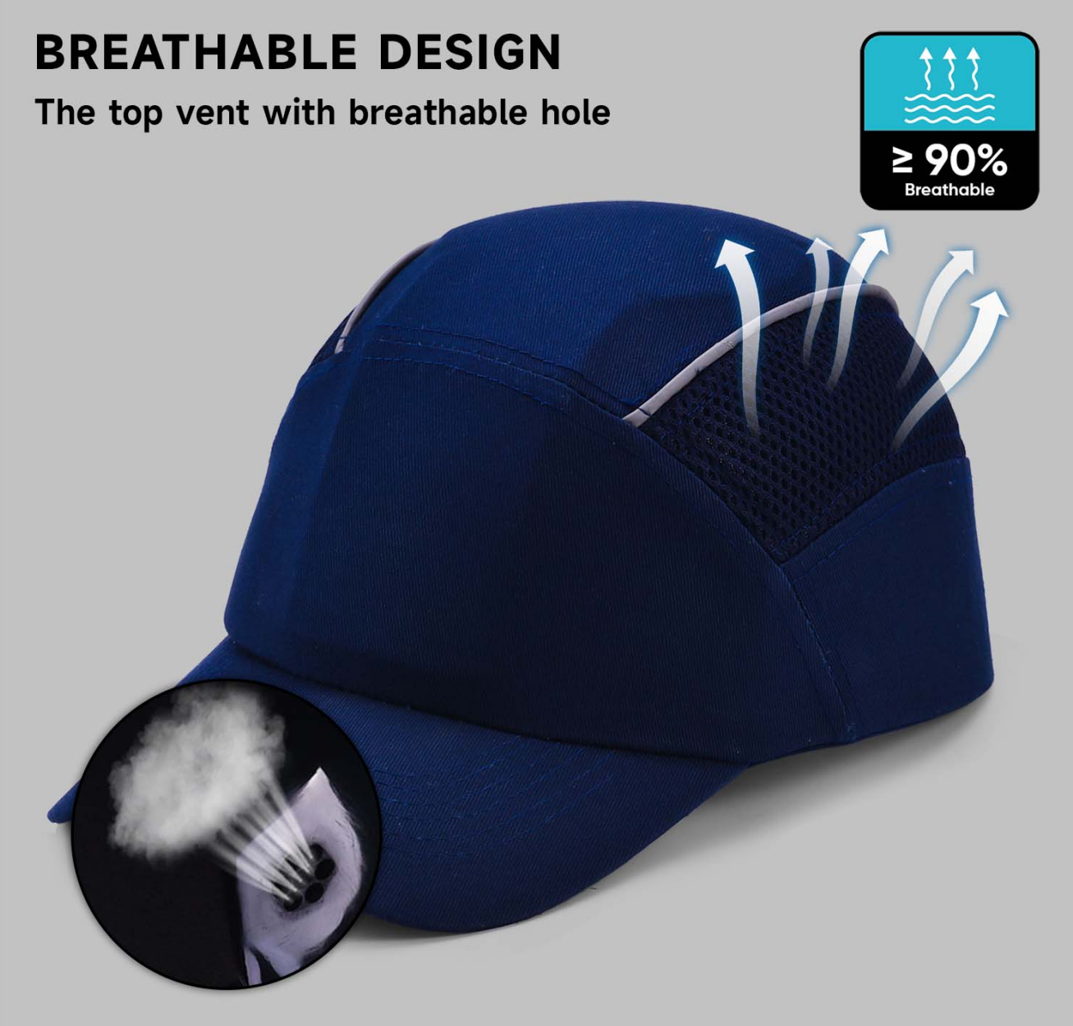
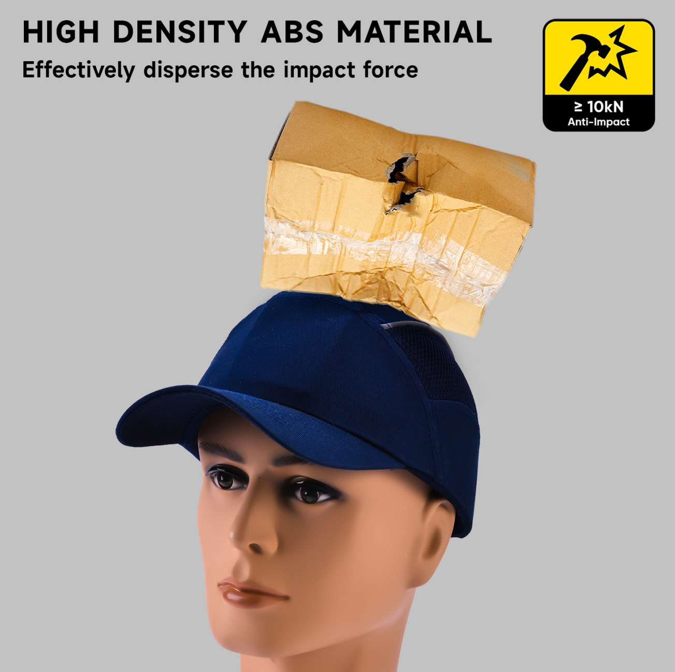
Head Protection
Baseball Design Safety Cap . WH-001 (DefendStrike)
Inner Shell : Removable & Comfortable ABS+EVA
Shape : The Ergonomatically Shaped Hard Shell
Head Hoop : Fastening And Soft Foam Insert Cushions
Band : Velcro Closure
Color Available : Black, Blue, Orange, Red etc
CE EN812:1998
√ Breathable
√ Impact Resistance

Slide 2
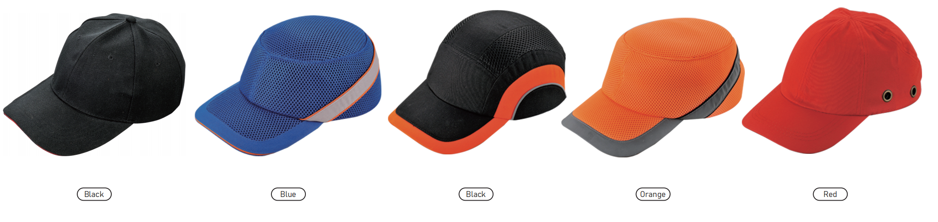
EN 397+A1:2012 √ Shock Absorbing Test (6.6)
Conditioning(°C) | Requirement | Defects | Result
Low Temp: -10±2 | ≤5000kN | Not Occurred | Pass
High Temp: +50±2 | ≤5000kN | Not Occurred | Pass
√ Resistant to Penetration(6.7)
Conditioning(°C) | Requiment | Test | Result
Low Temp: -10±2 | 585(NF EN960:08/2006) | No Contact | Pass
After Immersion | 585(NF EN960:08/2006) | No Contact | Pass
High Temp: +50±2 | 585(NF EN960:08/2006) | No Contact | Pass
Artificial Aging | 585(NF EN960:08/2006) | No Contact | Pass
Color Available: Black, Blue, Orange, Red etc
Users Instruction:
1.) APPLICATION AND LIMITATION OF USE
This helmet is designed to provide limited head protection by reducing the force of small falling objects striking or penetrating the top of the shell. It was not designed to provide front, side, or rear impact or penetration protection, while it may protect against light bumps to these areas.
Avoid contact of these devices with electrical wires, very low temperature (-20 ℃ or -30 ℃ and very high temperature (+150℃)
2.) PRE-USE INSPECTION
Always do a visual inspection of the helmets immediately before use to ensure that it is in a serviceable condition and operates correctly. The helmet should have no sharp, burr, damaged, missing part, cracks, nicks or breaks.To ensure the safety of users, the device should be regularly periodic examinations per a month by a competent person strictly in according with manufacturer's periodic examination procedure for continued efficiency and durability of the device.
3.) LIFESPAN
The helmet can be expected to remain in service for 5 years or more, when it is not damaged during use.
4.) CLEANING AND DISINFECTION
Clean the helmet with mild soap and lukewarm water. Do not use paints, solvents, chemicals, adhesives, gasoline or like substances on this helmet. The impact resistance and other protective properties of the helmet may be destroyed by such substances. The loss of these protective properties may not be apparent or readily detectable by the user. After each use, disinfection should be done and the use of agents that are not known to be harmful to th
5.) STORAGE
Store the helmet in a cool, dry and clean place out of direct sunlight. Avoid area where heat, moisture, light, oil, or their vapours or other degrading elements may be present.

